Slide 1



KALPATARU INSTITUTE OF TECHNOLOGY,TIPTUR
VISVESVARYA TECHNOLOGICAL UNIVERSITY, BELGAUM
ELECTRONICS AND COMMUNICATION ENGINEERING
INTERNSHIP REVIEW PHASE -2
“Android App Development Using Gen-AI”
PRESENTED BY
TEJAS P : 1KI22EC109

Slide 2
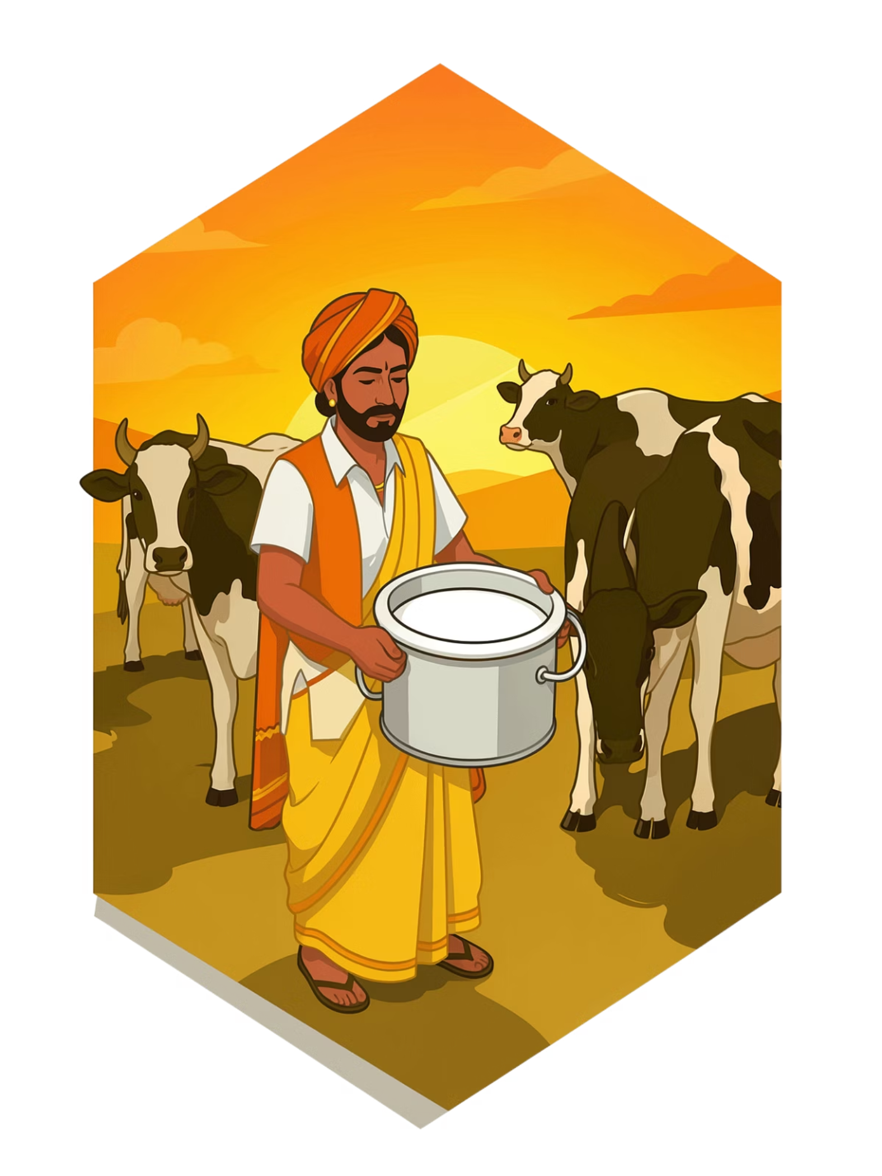
Ksheera-Sagara
Dairy Profit Intelligence for Farmers
An Android app powered by GenAI that transforms daily milk slips into clear financial insight — helping dairy farmers move from survival to profitability.
INTERNSHIP PROJECT
ANDROID + GENAI
AGRICULTURE

Slide 3

The Problem: Farmers Don't Know They're Losing Money
Every day, dairy farmers receive a Milk Slip showing fat content, SNF, and payment. But that's only half the picture.
💸 Hidden Costs
📉 Silent Losses
Feed, medicines, electricity, and labor costs are never subtracted from income.
Many farmers operate at a loss without ever realizing it.
📊 No Financial Tool
No accessible tool exists to track monthly profit or cow-wise performance.

Slide 4
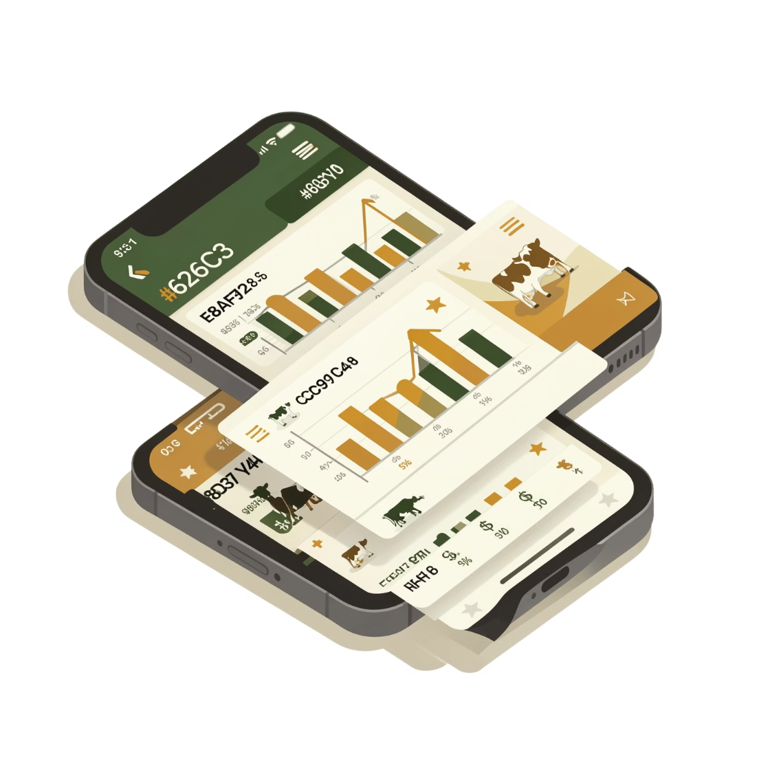
Objectives
Track Daily Income
Record All Expenses
Log liters and fat% from the milk slip to calculate real revenue.
Categorize costs: Fodder, Medical, Labor, Electricity.
Calculate Net Profit
Enable Smarter Decisions
Show a clear Profit/Loss indicator per liter and per month.
Help farmers decide when to reduce costs or cull non-productive cows.

Slide 5

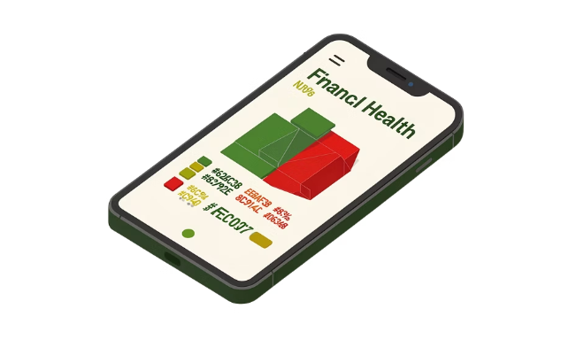
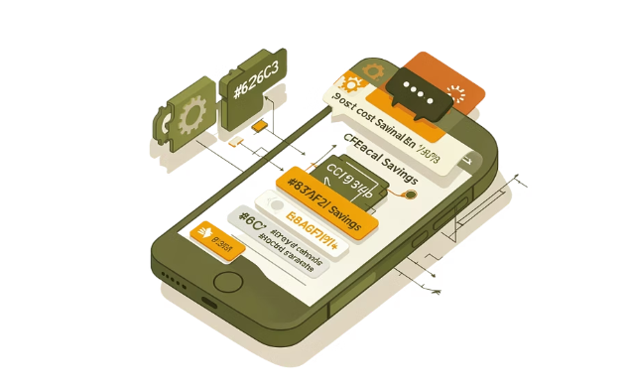
The Vision: What is Ksheera-Sagara?
Ksheera-Sagara ("Ocean of Milk") is a dedicated Dairy Profit & Loss Calculator for cow owners. It's not just a diary — it's a financial advisor in your pocket.
Simple Data Entry
Instant Financial Health
GenAI Cost Tips
Enter milk slip data and expenses in seconds — designed for low-literacy, rural users.
A Green/Red dashboard shows whether the farm is profitable this month.
The app suggests ways to reduce costs — like switching to home-grown fodder.

Slide 6
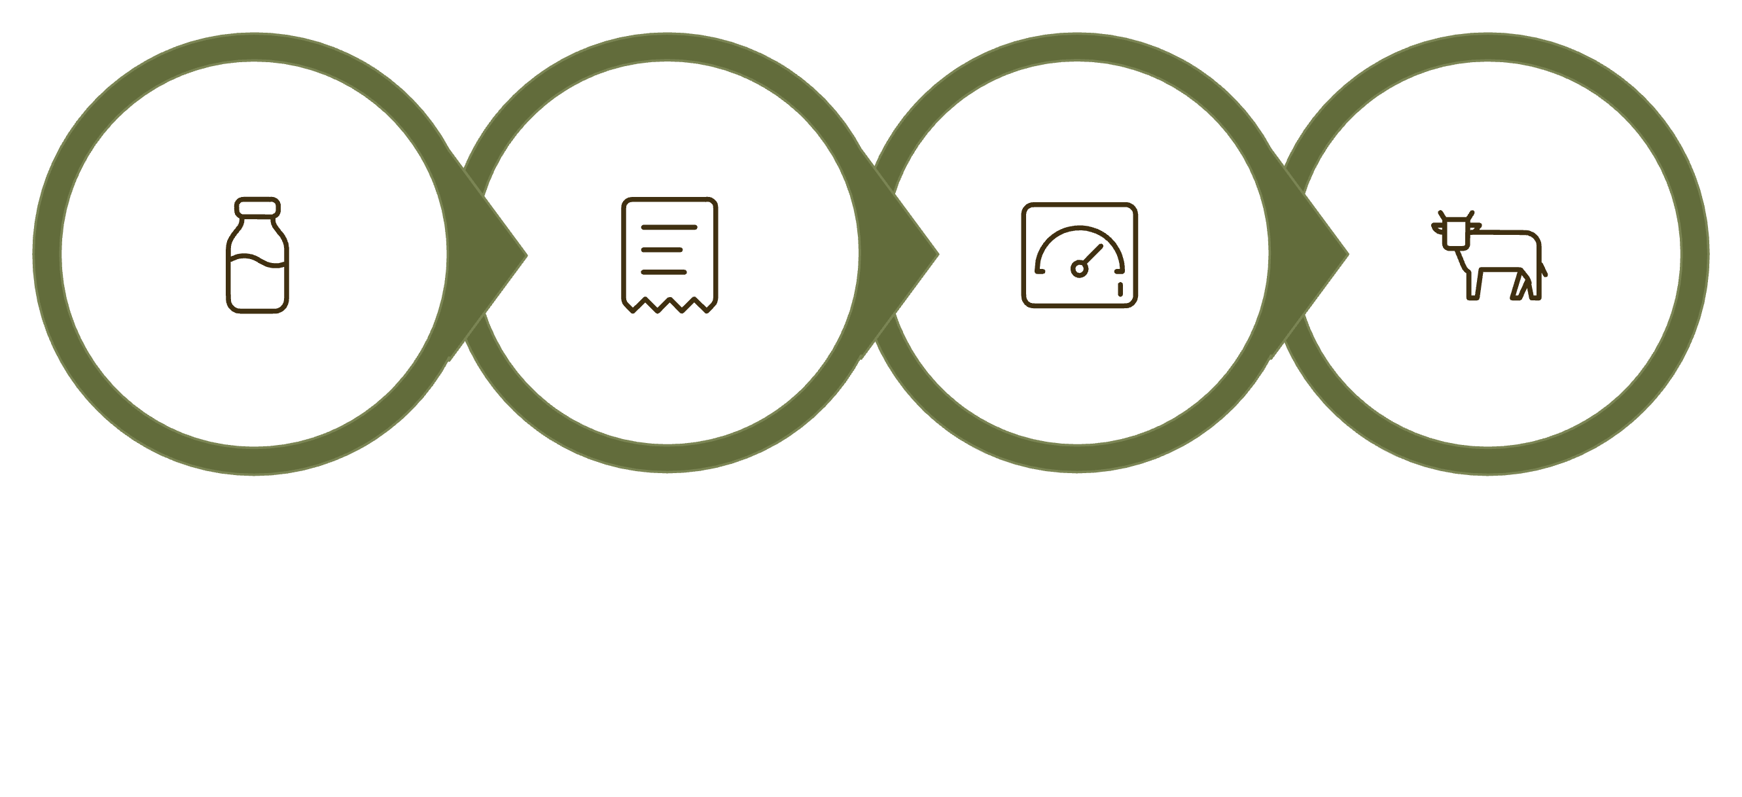
User Flow: How the App Works
Profit Dashboard
Cow-wise Analysis
Income Log
Expense Log
The app guides farmers through a simple daily routine — log income, log expenses, and instantly see their financial standing. Multi-cow farmers can compare profitability per animal.

Slide 7

Methodology & Technical Implementation
Tech Stack
Core Formula
Net Profit = Total Income − Total Expenses
Profit per Liter = Net Profit ÷ Total Liters Sold
Room DB
MPAndroidChart
Expense categories: [Fodder] · [Medical] · [Labor] · [Electricity]
Local storage for a full year of daily entries — works offline.
Pie charts visualize expense breakdown: Feed vs. Meds vs. Labor.
GenAI Integration
PDF Export
Generates personalized cost-saving recommendations based on input data.
Monthly financial summaries shared as PDF or image via WhatsApp.

Slide 8

Research & Background
Why This Problem Matters
India is the world's largest milk producer, yet smallholder dairy farmers lack basic financial tools. Studies show most operate without tracking input costs, leading to invisible losses.
Financial Literacy Gap
Smartphone Penetration
GenAI Opportunity
Most farmers understand "income" but not "net profit" after expenses.
Android adoption in rural India makes a mobile-first solution viable.
AI can translate raw data into actionable advice in local language.

Slide 9

Impact Goals
🌱 Entrepreneurial Farming
📈 Data-Driven Decisions
Shift dairy from a "survival activity" to a profitable, data-driven business.
Help farmers make informed choices — like when to sell a non-productive cow.
💡 Financial Literacy
Teach the core concept of Input Cost vs. Gross Income to rural communities.

Slide 10
Advantages & Success Criteria
What Makes Ksheera-Sagara Different
Success Criteria
Cow-wise profitability — compare which animal earns the most.
App generates a Monthly Financial Summary as PDF/Image
Expense entry has categories: Fodder, Medical, Labor
UI is clean and centered on "Money" metrics
Profit/Loss indicator is visible on the home screen
Offline-first design — works without internet in rural areas.
Shareable reports — monthly PDF summaries for cooperatives or loans.
AI cost tips — personalized suggestions to improve margins.

Slide 11

Conclusion
Ksheera-Sagara bridges the gap between daily milk production and real financial awareness. By combining Android development with GenAI, this project empowers dairy farmers to make smarter, data-backed decisions — turning invisible losses into visible profit.
🎯 Problem Solved
🤖 AI-Powered
Farmers finally see their true profit after all costs.
GenAI turns raw numbers into actionable advice.
🌍 Real Impact
Financial literacy for rural dairy communities at scale.

Slide 12
THANK YOU

